Slide 1
MO

Slide 2
Webinar
You have all been muted
Questions can be typed into the “Question” feature.
We will answer as many as we possibly can after this presentation.
A copy of the PowerPoint presentation will be sent to each registrant after the webinar.
JD

Slide 3
Now is the Time to Put the Pieces Together

Slide 4
Reopen Planning
Assess
Account
Plan
Communicate

Slide 5
Forecast Your Cash Flow
 | Mo 1 | Mo 2 | Mo 3 | Mo 4 | Mo 5 | Mo 6 | Mo 7 | Mo 8 | Mo 9 | Mo 10 | Mo 11 | Mo 12
Starting Cash
Cash In
Disbursements
Ending Balance
https://capecod.score.org/resource/12-month-cash-flow-statement

Slide 6
Preparing for Cash / Expense Analysis
Gather all financial records to use as a reference as you create your cash flow forecast.
A forecast is never exactly correct. It represents a point in time or a specific scenario that requires regular updating.
Records: 2017 and 2018 business and personal tax returns and 2019 business tax returns. 2019 P&L, Balance Sheet and Cash flow statements – these are needed if you are planning to talk with lenders in the future.
Review your cash flow forecast with someone you trust, including a SCORE mentor.

Slide 7
Analyzing Expenses
Expense analysis
think about must have,
nice to have,
don’t need
Payroll analysis
consider must have,
need, but can do without,
can do without
How much cash infusion will you need to survive?

Slide 8
Rules of Expense Management
Rule #1 – Cut early
Rule #2 - Cut BIG
Rule #3 - Double your initial estimate
Best to estimate for a slower, longer recovery & adjust if a better situation vs. being to aggressive
Multiple cuts - devastating to you and your employees.
ML

Slide 9
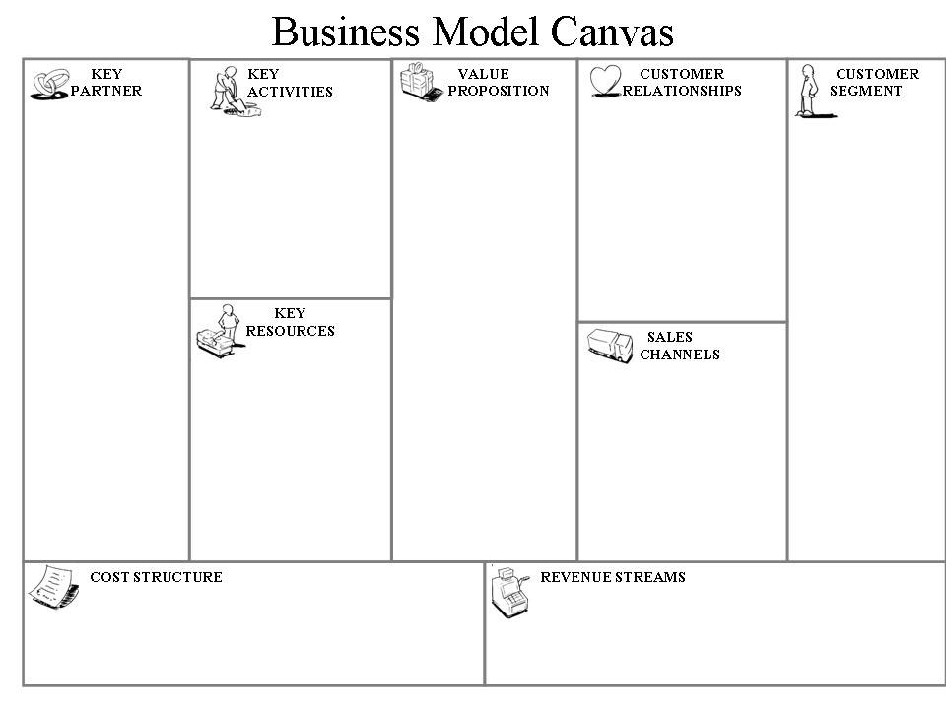
Re-think your Business Model

Slide 10
What is the status of your business?
Closed
Partially Open
Totally Open
To what degree has COVID19 impacted your business?
Open – some impact / Closed – lots of impact
How to deal with opening in stages

Slide 11
Physical Customer Interaction
Customer
Little Engagement
Moderate
Engagement
Totally Engaged
Everything depends on customer proximity
How can you make them feel you are protecting their health?
Will the customer’s behavior change? For how long?
How can you adapt? Social distancing? Cleaning?
These issues are not going away quickly!

Slide 12
Staffing
Near term, Intermediate term, Long term?
Will your staff be available?
What do your employees need right now?
Whole or partial reimbursement for lost wages?
Equipment, material, supplies or assistance for working from home
Put them to work in other capacities?
Have them brainstorm what the future might look like?
Be Human - your loyalty now will impact your future
Explain your decision process where you can
Needs in the new normal
Stay home if ill
Take temp before coming to work
Use PPE as needed

Slide 13
Training - ReTraining
Yourself
Your Staff
Your Customers
JD

Slide 14
Supply Chain
Very Little Impact
Reduced Flow
Locate New Sources of Supply
Communicate with your suppliers
Are all items in stock?
Have lead times increased?
Payment terms?

Slide 15
Pivoting
Examples of pivots a company can make include:
Targeting a different segment of the market
Developing a new product or product line
Changing the revenue model or business model to improve profitability
Altering the process to change the product or service
Moving business on line
Offering pickup and delivery

Slide 16
Pivoting
What will the new model look like?
What can you do to protect existing revenue?
Who can you partner with to create new events, services, opportunities?
What else can you do to generate revenue?
What needs do the pandemic create to put idle resources to work?
How might you modify the customer experience to make it safer, yet effective?
What physical accommodations can you undertake to make customers and employees feel and be safer.
What other funding sources are there? Keep up to-date with other funding sources, loans and grants.
MG

Slide 17
Communications
Who
With creditors/lenders/landlord/utilities/insurance company
With suppliers, equipment lessors, marketing & advertising firms
With current customers – what are their expectations?
With potential customers
With employees

Slide 18
What - Communications
What is your message to each group?
Clear, forward looking and honest messaging that inspires
For Customers
Thank them
Explain what you are doing now that will affect them
Detail changes
Share updates
Update the way you connect
Be assuring
Create content that is helpful

Slide 19
Communications
How – how will you communicate your message?
Social media
Blog posts & social posts
Traditional media
Video
Person-to-person via written communications
Person-to-person via digital communications

Slide 20
Question and Answer
Today’s presentation has been published on SCORE Cape Cod’s website - www.capecod.score.org

